Slide 1
Name...
Tagline...

Slide 2
Team members
……………………….
……………………….
……………………….

Slide 3
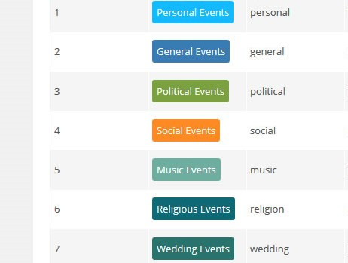
About project
This project is about getting all the events that take place near by user in a city. By using this app user can choose their favorite events and also can get notification. This app contain every single information about events such as category, location ,poster and so on.

Slide 4
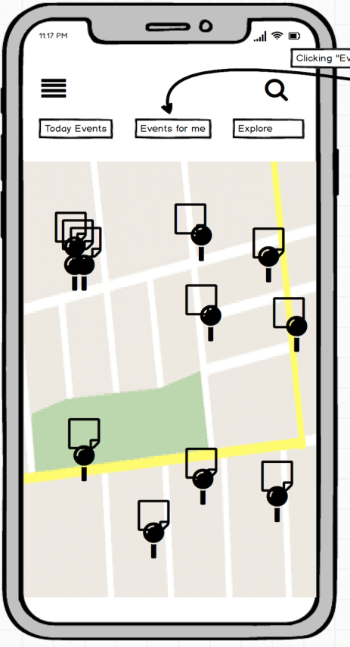
vision
It’s vision is to make people more aware about events happening near by them. Everyone isn’t know about the events around the country but this apps will notify them within a moment in a easy way.

Slide 5
Objectives
To provide all types of event.
To help user attend those event.
To easily promote an event.
To gather information related to the event.
To get notified about every events.
To reduce fake events.

Slide 6
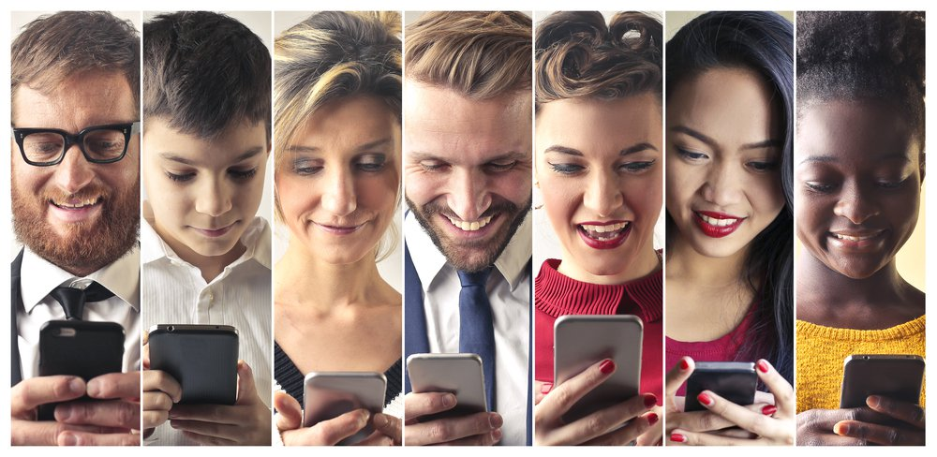
Advantage for society
Secure from fake events
No chance of being fraud by anyone.
It create new ideas for more new events.
Using minimum time and get maximum knowledge.

Slide 7
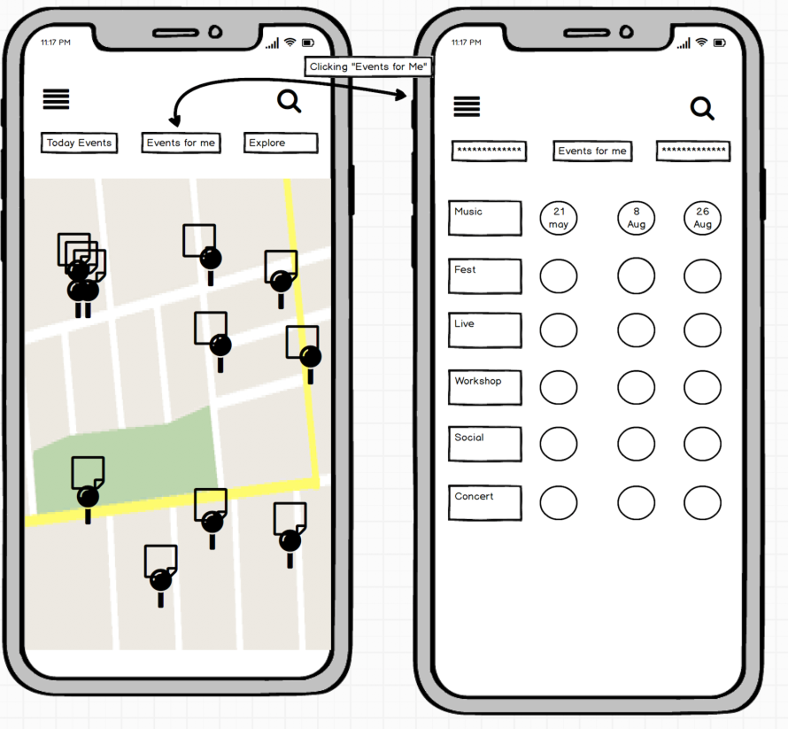
Design

Slide 8
Problem/Solution
What is the problem you are trying to solve?
  .
  .
What impact does this project have on society?
  .
  .
What is your solution to the problem?
  .
  .

Slide 9
Planning & Implementation
Market Size.
  .
  .
Budget & Financial Plan.
  .
  .
Technology Use.
  .
  .

Slide 10
